Slide 1
All About Mrs. Cravens
By Me

Slide 2
My Family
My Husband: Jim
My Daughter: Christina
My Daughter: Lindsay
My Daughter: Alexis

Slide 3
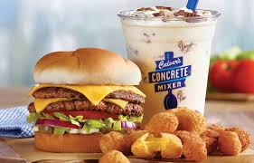
My Favorite Places to Eat

