Slide 1
Feliz Navidad
Christmas in Mexico
BY: Carolina Vergara

Slide 2
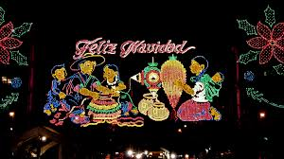
The First Christmas in Mexico
Many of Mexico’s Christmas traditions came from Old Spain. These traditions were originally introduced during the colonial era as a means of teaching Christian morals and the Bible to the Indians.
The first Christmas in Mexico was celebrated in 1538 by Fray Pedro de Gante. The Indians enjoyed the new feast day and celebrated it by adding their own colorful touches of flowers and feathers.

Slide 3
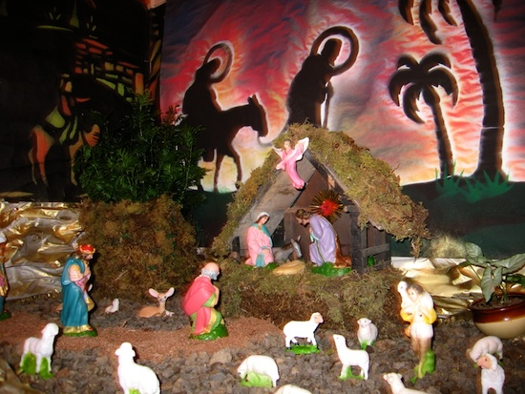
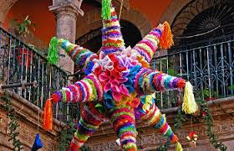
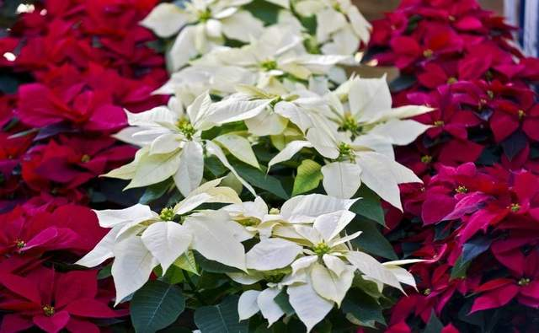
Decorations During Christmas in Mexico
The most traditional and important Christmas decoration is the Nativity scene. Most families set it up by December 14 and it is left out on display until February 2.
Many homes decorate with poinsettia flowers, which are native to Mexico
The piñata is part of the décor during las posadas, they are usually in the shape of a star.
Christmas tree ornaments are often handmade of glass, straw, and pottery. Mexican homes typically decorate with earth tones instead of the usual red and green.

Slide 4
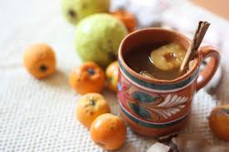
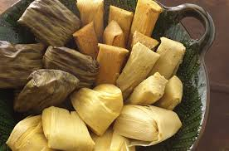
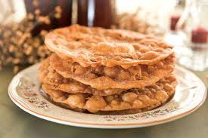
Traditional Foods Served During Christmas
After the posadas typical foods eaten during this time of year are tamales with a variety of fillings. Ponche Navideño is served as well. This Mexican hot fruit punch is made with Mexican hawthorn, guavas, apples and piloncillo.
During the Christmas Eve feast many families eat Bacalao, which is dried salted codfish, it is stewed with tomatoes, capers, olives, and potatoes.
Other common foods are Pozole, Romeritos and turkey.
A tasty treat that Mexicans enjoy during Christmas time are Buñuelos. They are fried flour tortillas sprinkled with sugar, cinnamon, and syrup.

Slide 5
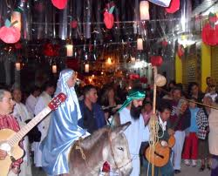
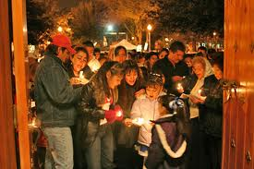
Christmastime Traditions
The Christmas celebrations in Mexico start on December 16th with “Las Posadas”.
La Posada is a religious procession that reenacts the search for shelter by Mary and Joseph before the birth of baby Jesus. During the procession celebrants go from house to house singing and carrying the images of Mary and Joseph looking for shelter.
Each Posada ends with a piñata being broken and a meal is served to all the celebrants.
On Christmas Eve, the last posada is celebrated and everyone goes to La Misa de Gallo in the evening. Following the mass, there is a traditional midnight feast.

Slide 6
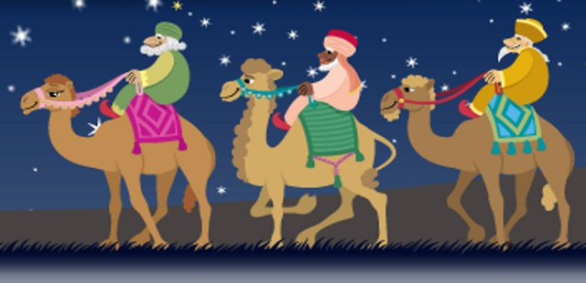
Christmastime Traditions
Christmas day in Mexico is quiet. To children in many parts of the world, December 25th means gifts. The children of Mexico have a different tradition, their big day comes until January 6^{th,} Dia de Los Reyes Magos.
In Mexico, Santa Claus doesn’t bring gifts, it is “Los Tres Reyes Magos” or three wise men who bring the gifts and leave them near the shoes of small children.
In addition to the gift giving, it is traditional to eat “Rosca de Reyes”, which is baked with a small plastic figurine representing baby Jesus.

