Slide 1
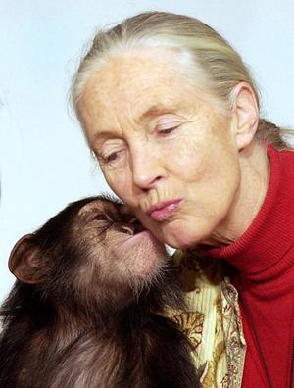
Who am I?

Slide 2
I was born April 3, 1934.

Slide 3
I was the international recipient of the 1996 Caring Award for Scientific Achievement.

Slide 4
I am the world’s foremost authority on chimpanzees, having closely observed their behavior for the past quarter century in the jungles of the Gombe Game Reserve in Africa.

Slide 5
I am Jane Goodall.

